Slide 1

Street food management
Objectives:
the shops to be registered on the system then the whole item list that stall is feed in the system which is made available to all the people or users of the system.
Now users come to the system online and search their desired through different filter given to him according to the shop and taste of food he wants. He can select the food and give orders according to the quantity.
Here we have the option of the delivery boy
Project Associates
I.Sujan
K.Harish

Slide 2
ENVIRONMENT
Technologies Involved
Backend technologies:
Java 1.8
API
Servlets
Log4J
Front End
HTML 5
CSS 3
Java Script
Bootstrap 3
Server
Apache Tomcat 8.5
Database: MySQL workbench

Slide 3

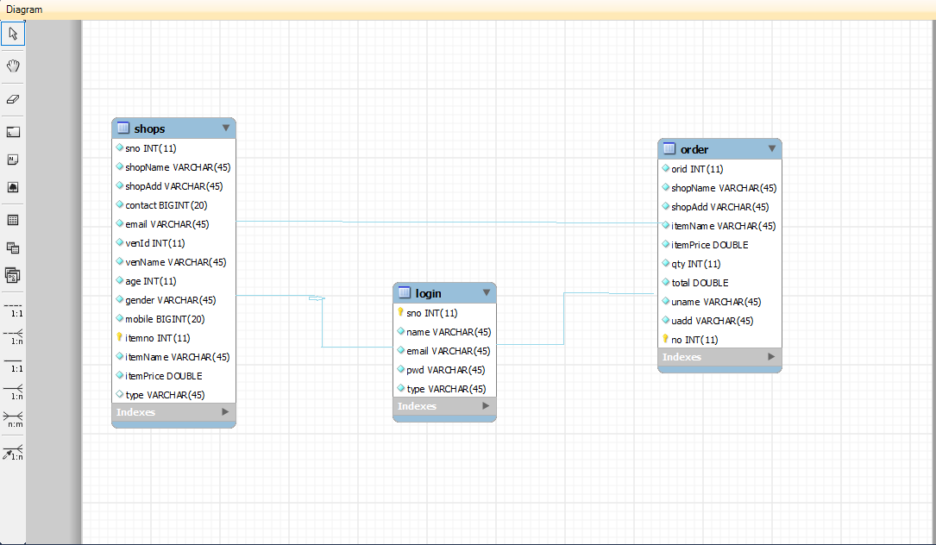
Entity Relationship Diagram

Slide 4
Functional Specifications
Admin
Admin can only View the data AND Manage the data like
Update delete and Search by shop Name.
Vendor
Has to register with shop number and Add shop with Item
Menu
User
Will have an Access to view All the shops And Add to Cart Then
Place Order
Delivery Boy
Can Report status As Delivered

Slide 5

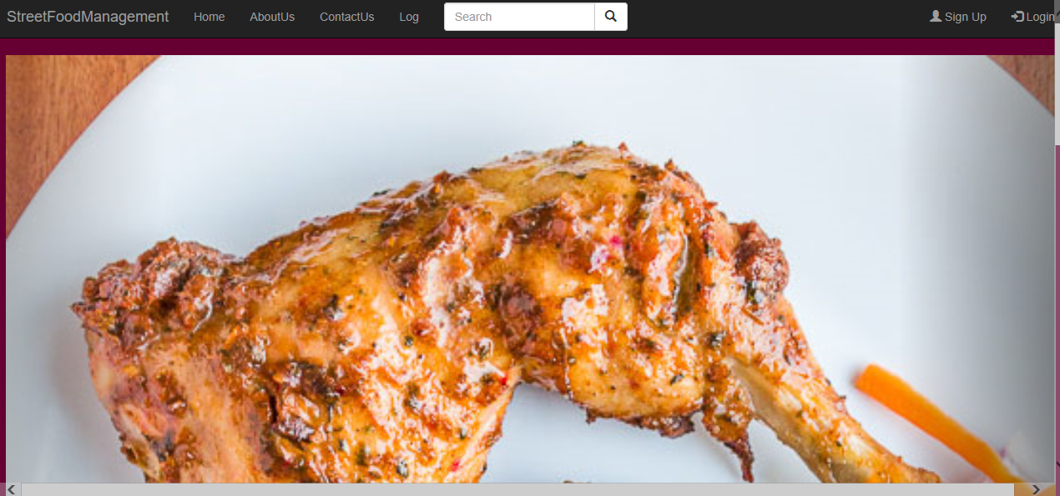
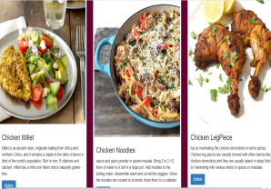
Home Page

Slide 6

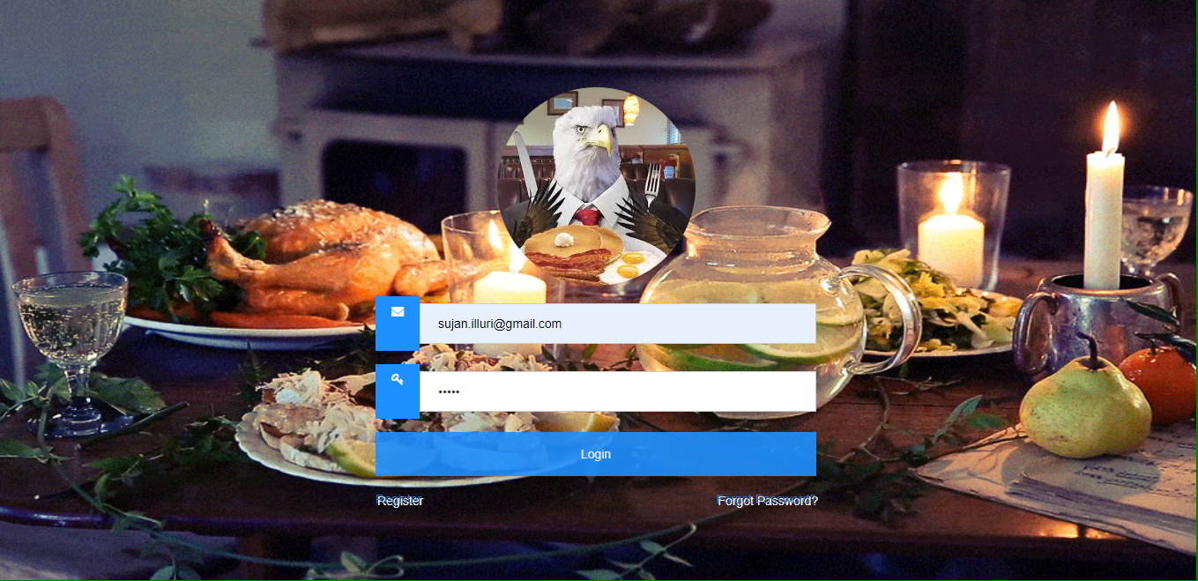
Login

Slide 7
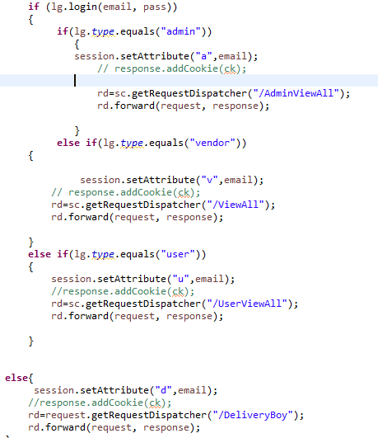
Login Implementation

Slide 8
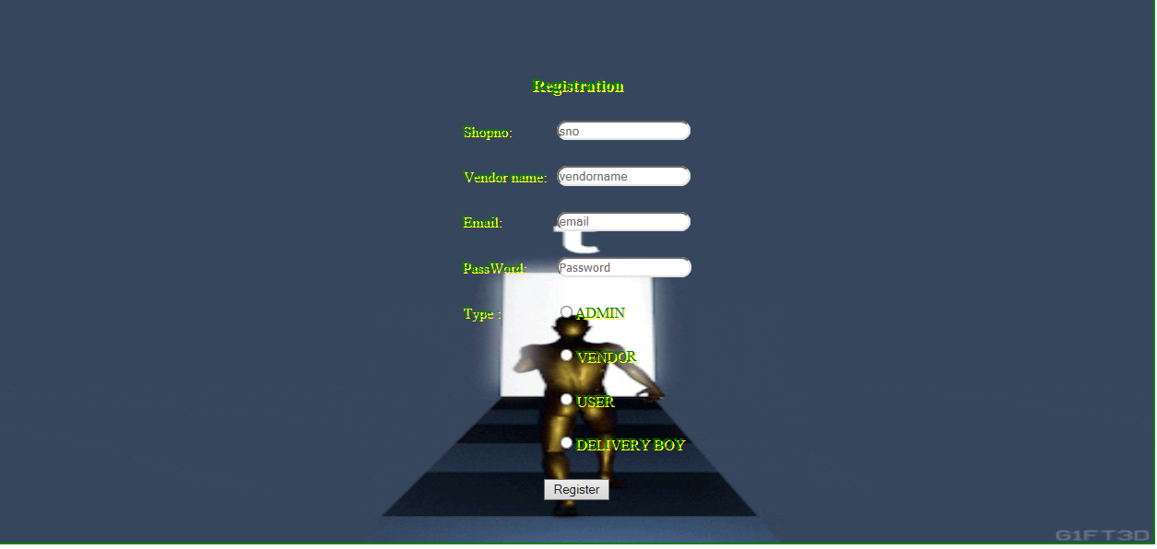
Register

Slide 9
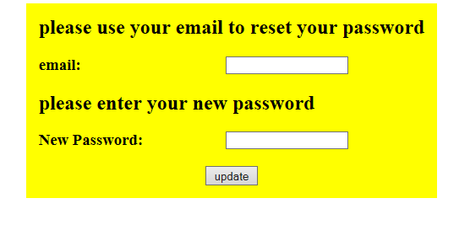
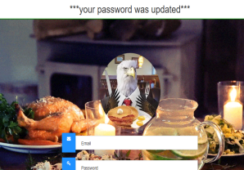
Forget Password

Slide 10

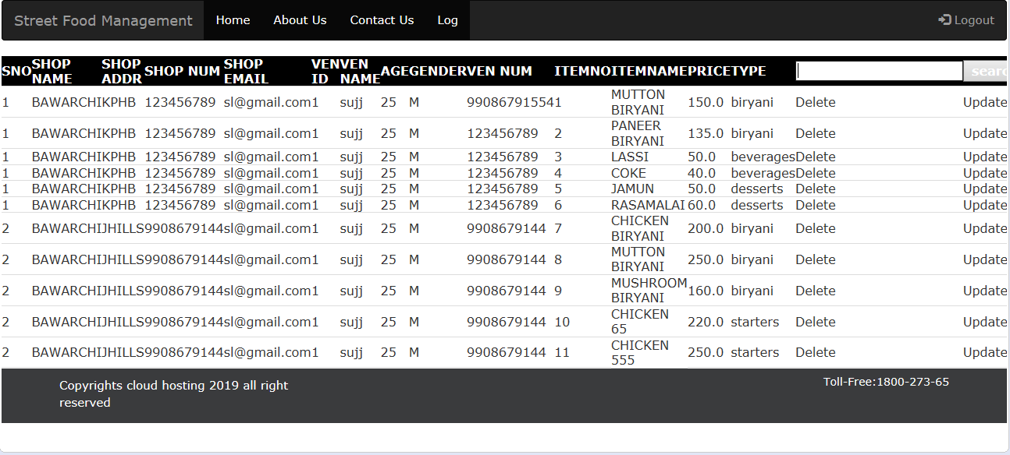
Module Specifications-Admin
The Admin Has View all and Update Operation, Deletion Operation with Search bar Option to Search by Shop Number

Slide 11

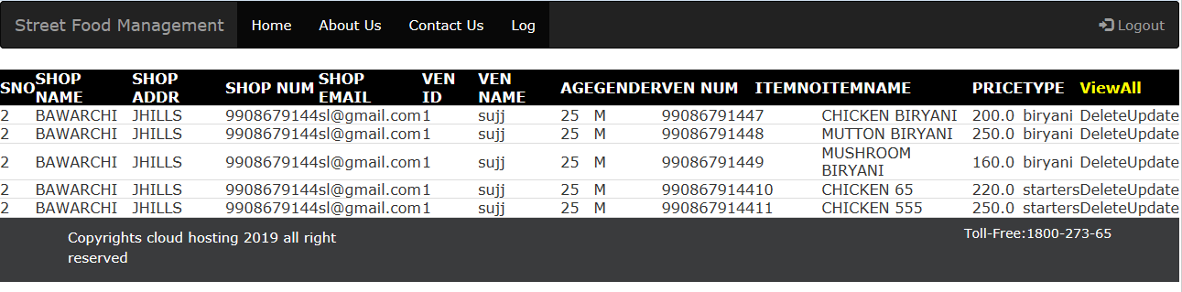
Admin View

Slide 12
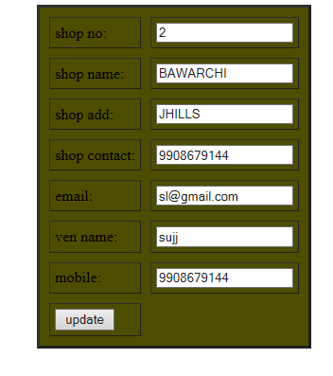
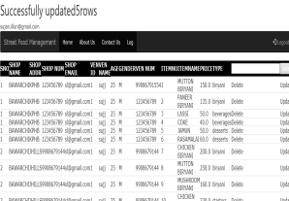
Admin Update

Slide 13
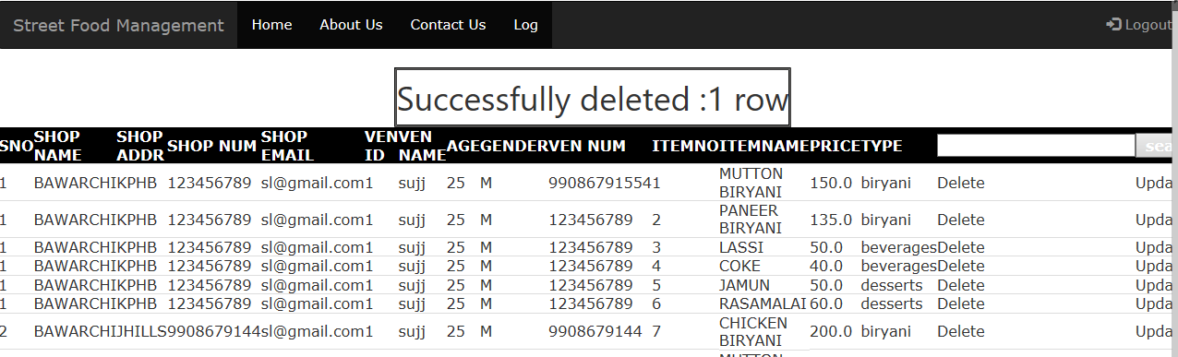
Admin Delete
pw.println("<td>"+"<a href=AdminDelete?sno="+s.getSno()+">Delete</a>"+"</td><td>"+"<a href=AdminUpdate?sno="+s.getSno()+">Update</a>"+"</td></tr>");

Slide 14
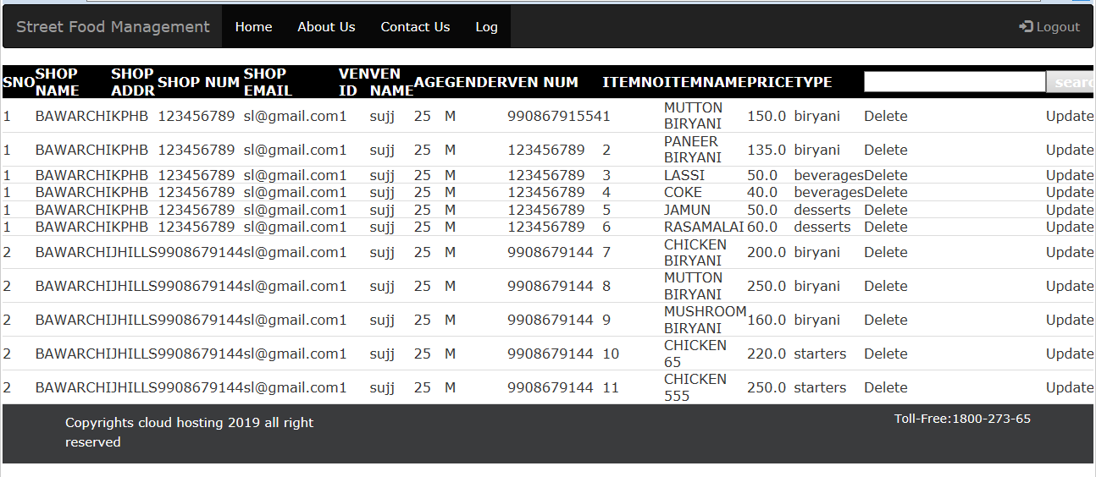
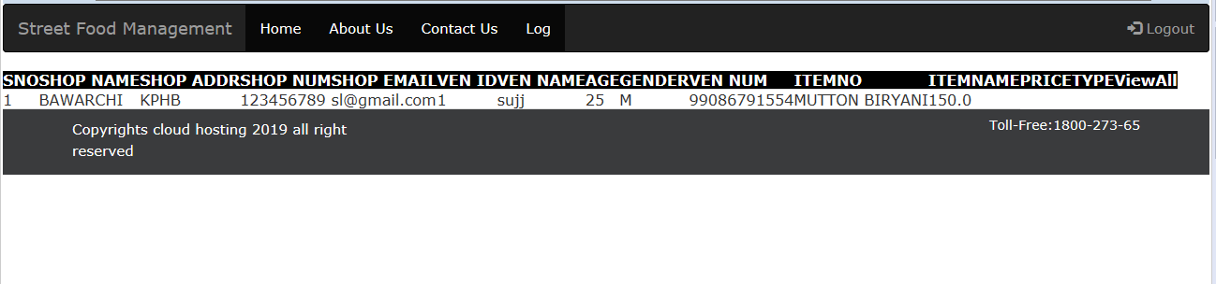
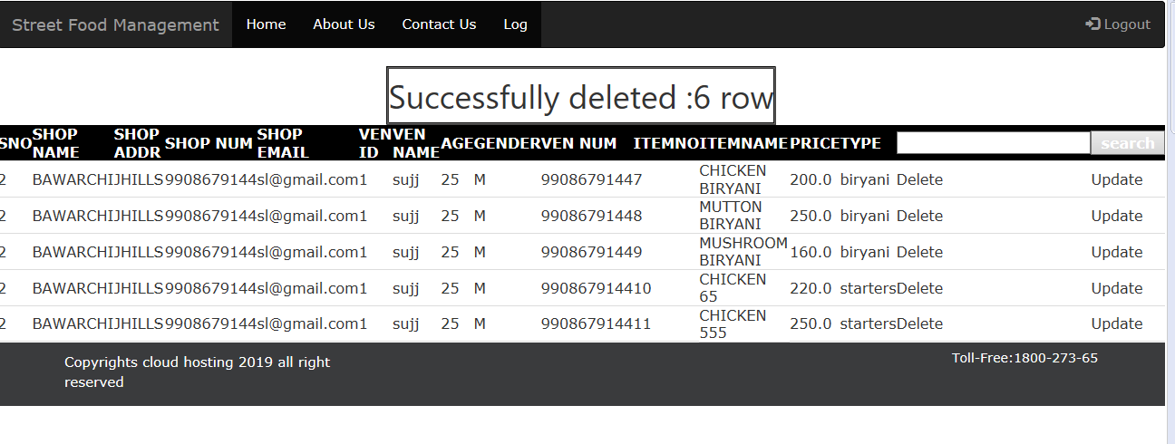
Module Specifications-Vendor
View Only one
Payments and Orders Information

Slide 15
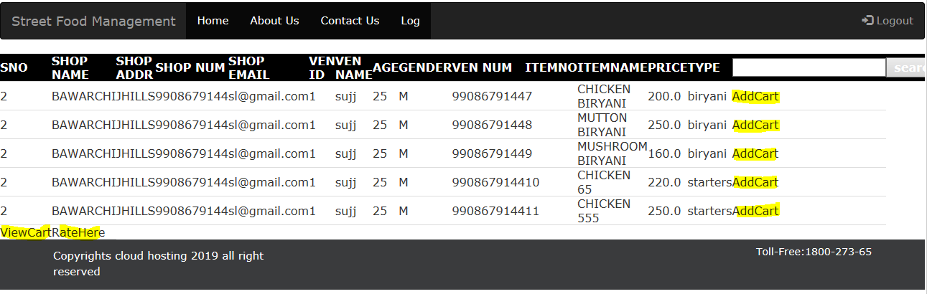
Module Specifications-User
User Registration Followed by Login

Slide 16

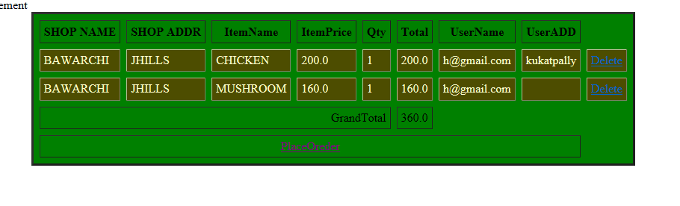

Slide 17
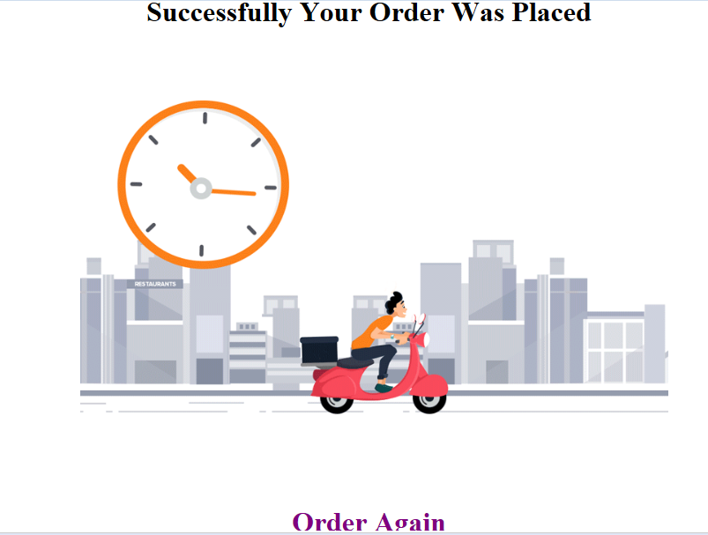
User Place Order
User Menu
Getting Customer Profile using Email

Slide 18
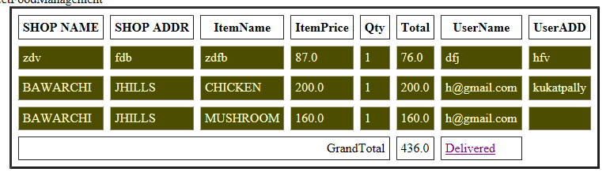
Delivery Boy

Slide 19
Research and Development
Future Scope
Navigation system
Payment Gateway
Search by both shop name and shop number
Menu items with associated pictures
Shop availability
Filters
Number of delivery boys

Slide 20


